Slide 1






Water Level Indicator

Slide 2




Project by
Bhoomika - 221EC136
Under the guidance of
Dr Sandeep Kumar
Electronics and Communication Department, NITK

Slide 3






Table of Content
1. Introduction
2. Problem Statement
3. Objectives
4. Work plan
5. Methodology &
Literature review
6. References & Future plan

Slide 4




Introduction
This project is about building a water level indicator using basic circuit elements.
The main motivation behind this project is to prevent the wastage of water .

Slide 5



Problem Statement
About 3000 to 5000 L of water is lost everyday due to the tank overflow which adds to 580,937,500,000 liters of water being wasted every year in India. This is a serious issue since fresh water is a limited resource.
To prevent this from happening and to decrease the wastage of water due to tank overflow a possible solution is the use of water level indicator so that, whenever the tank is filled, the user knows and prevents the overflow of tank.

Slide 6
Project Objectives
1.
To learn to build basic circuits using basic circuit components.
2.
To learn how a water level indicator works.
To simulate the circuit using software like LTspice.
3.

Slide 7
Work Plan
To build a water level indicator which will
indicate no light in case the tank is empty
indicate blue light if the tank is about 25% filled.
indicate green light if the tank is 50% filled.
indicate yellow light if the tank is 75% filled.
indicate red light if the tank is 90% filled and also the buzzer starts beep sound as a sign of warning.

Slide 8



Methodology
The basic idea is to use op-amps as comparators to identify the level of water in the tank.
Each op amp gets activated at different water levels.
The output of the op-amp is fed to 4 input AND gates in such a manner that only the LED that corresponding to a particular water level glows at a time.
Also, the output of the topmost op-amp is also connected to the buzzer to indicate that the tank is 90% full.

Slide 9
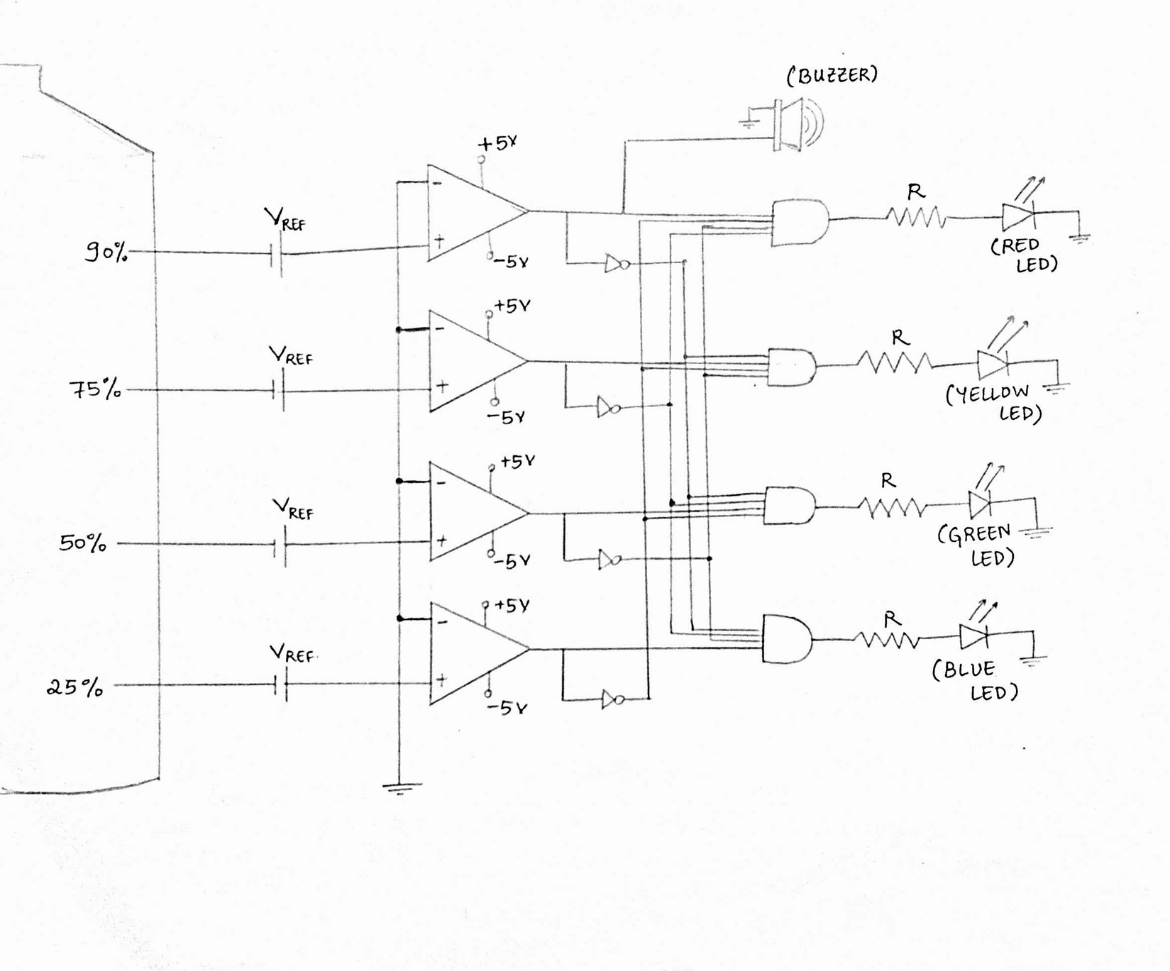
Circuit diagram

Slide 10
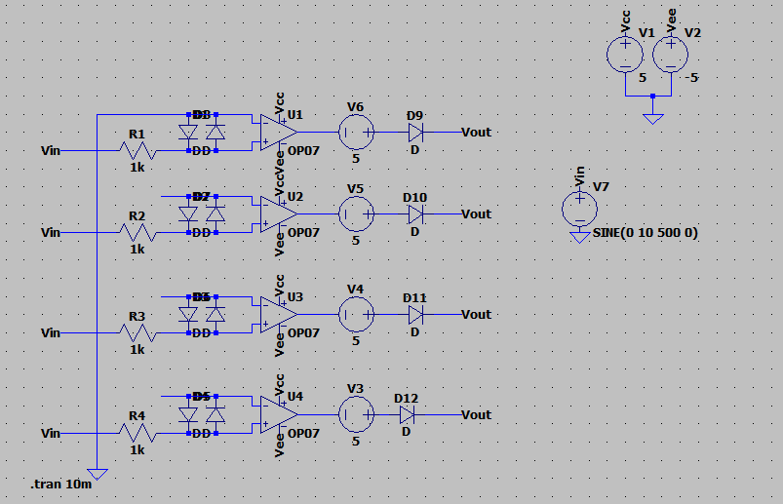
We made little changes in the circuit and we simulated it in Logisim and LT spice . They are as follows :

Slide 11
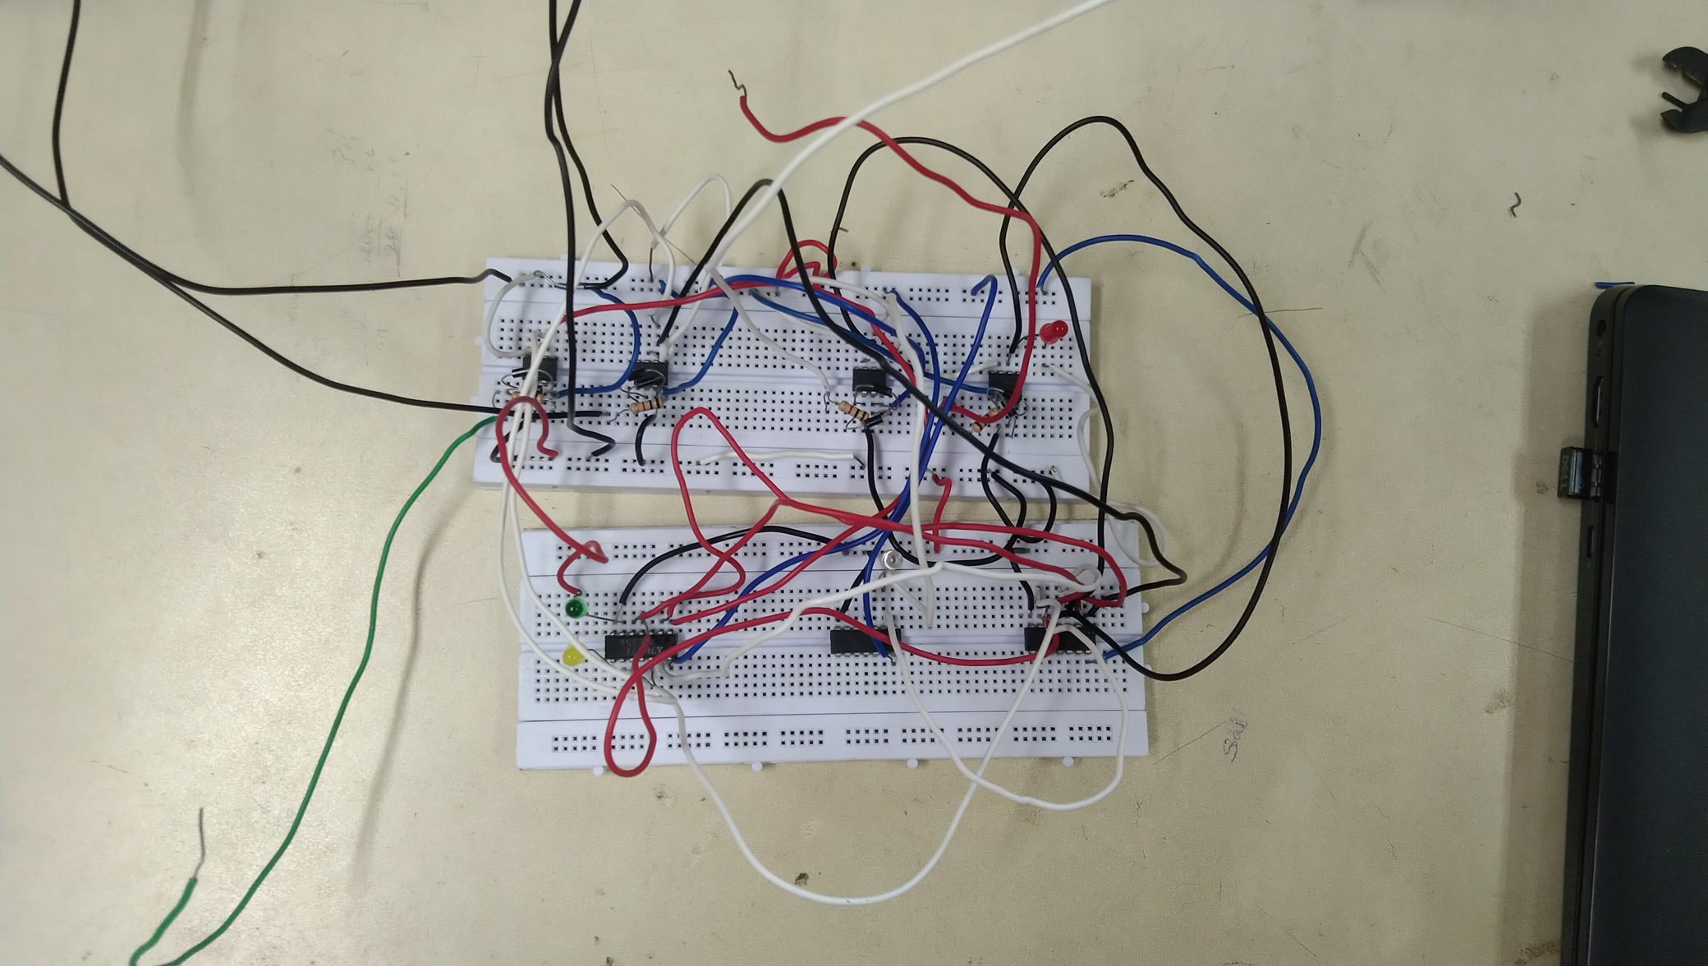
Hardware of the project

Slide 12
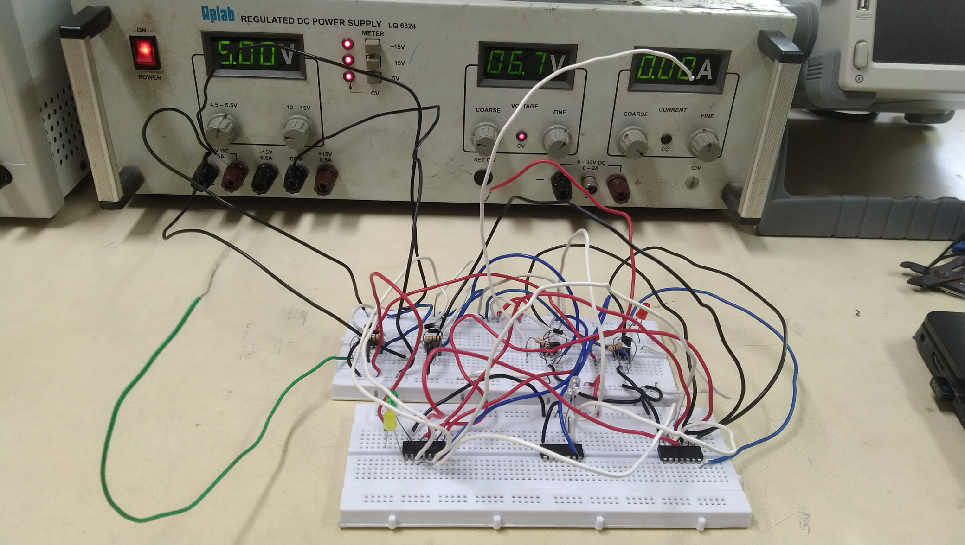
Add a

Slide 13
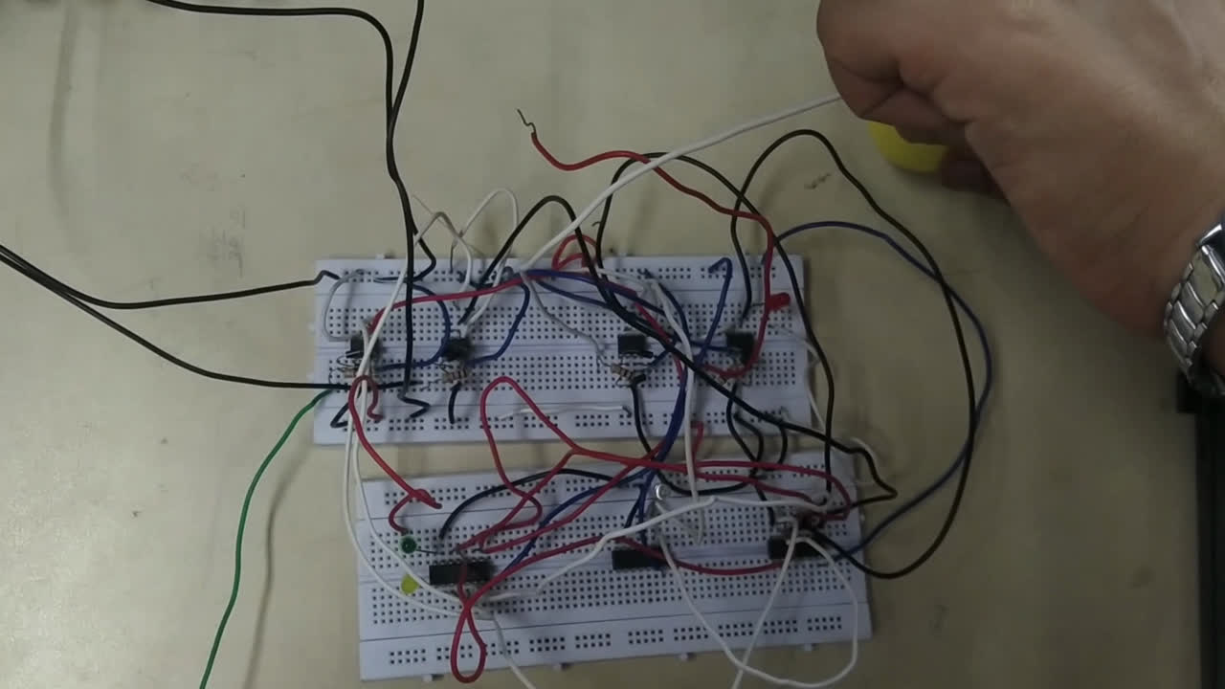

Slide 14


Literature Review
The water level indicator indicated the level of water in the tank. The indicator is made using op-amps functioning as a comparator. When the water reaches a particular op-amp, it gives an output of 5V which is used to on the LEDs.
The and gates are used to ensure that only one LED which corresponds to the desired level is glowing. The resistor added in series with the LED will make sure that excess current does not flow into the LED.

Slide 15



This water level indicator is different from the other water level indicator in its design i.e. the other water level indicators used Arduino or transistors while ours use op-amps.
Also, this water level indicator has the LED for a particular level only glowing but in the other designs, the LEDs for all the levels below the desired level also glows.

Slide 16


References
[1]. ENGR-120_Water-Level-Indicator.pdf,
https://www.subr.edu/assets/subr/ElectricalEngineering/
TargetedInfusion/Files/ENGR-120_Water-Level-Indicator.pdf [2]. Simple Water Level Indicator Alarm with Buzzer , Circuit Digest,
https://circuitdigest.com/electronic-circuits/simple-diy-
water-level-indicator-alarm-circuit.

Slide 17



Future Plan
Add a provision to the circuit which will turn off the water pump when water reached 90% and on the pump when the water level is below 25%.

Slide 18


THANK YOU !!!

